Slide 1
NOIR: Neural Signal Operated Intelligent Robots for Everyday Activities
Name:Angothu Muni
Enrollment Number:21CS002361
Supervisor: Dr. Alok Kumar
Domain Explored :Neuro Science,Robotic and Machine Learning

Slide 2

Introduction
Problem statement:-
Need for a general-purpose BRI that allows humans to control robots using neural signals to perform everyday activities efficiently.
Traditional method:BCI
Motivation:-
Benefiting the general population, senior citizens, and people with disabilities.
Individual needs of a Person
Automatic task
LLMs Models In AI compare to LSTM,RNN,GNT,BiDirection,GTs
Fig 1:Senior Citizien Motivation

Slide 3
Literature Review
Review of brain-computer interfaces (BCI) and related systems, focusing on applications such as EEG-driven prosthetics and navigation robots.
Limitations in existing BRI systems, which are often specialized for specific tasks or exist only in simulation
Current systems are often require substantial training.

Slide 4
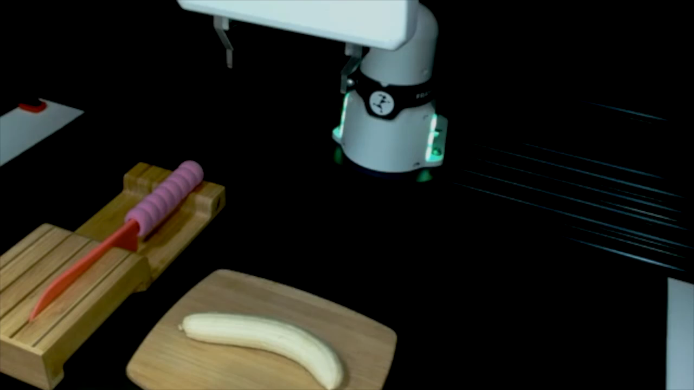
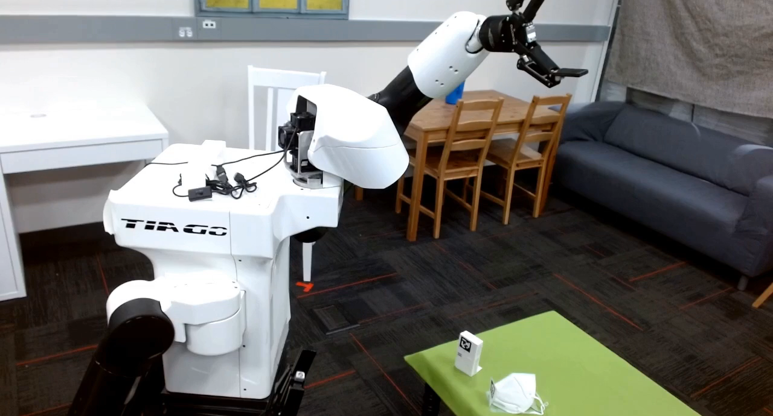
Research Gap
While many BRI systems focus on single or limited tasks, NOIR addresses the need for a versatile, adaptive system capable of handling a wide range of complex activities in real-world settings. The challenge lies in decoding human intentions accurately and making the robots intelligent enough to adapt and learn user preferences efficiently
Vid 1:Single Task Cutting Master
Vid 2:Multi Task Care Taker

Slide 5
Objective(s)
Develop a general-purpose BRI system that can perform various everyday tasks using neural signals.
Enhance the robot's ability to learn and adapt to individual users' intentions.
Improve the efficiency of human-robot interaction through neural communication
Enhancing User Experience Through Feedback [MI Module]
My Goal Implement a simple Model through EEG+ML Code+Stimulation Refer Synposis Again

Slide 6
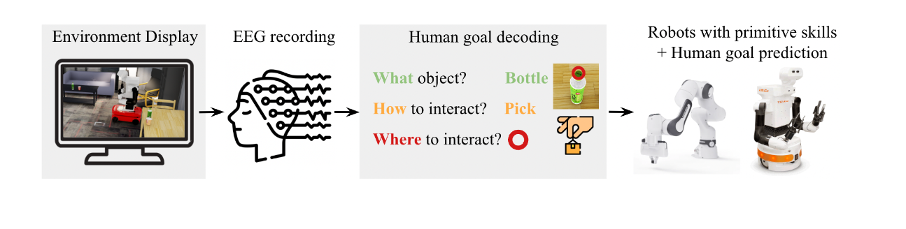
Methodology
Decoding Human Intention from EEG:
NOIR uses a modular pipeline for decoding human intended goals from EEG signals: (a) What object to manipulate, decoded from SSVEP signals using CCA classifiers; (b) How to interact with the object, decoded from MI signals using CSP+QDA algorithms; (c) Where to interact, decoded from MI signals. A safety mechanism that captures muscle tension from jaw clench is used to confirm or reject decoding results.
Fig 3:General View of System

Slide 7
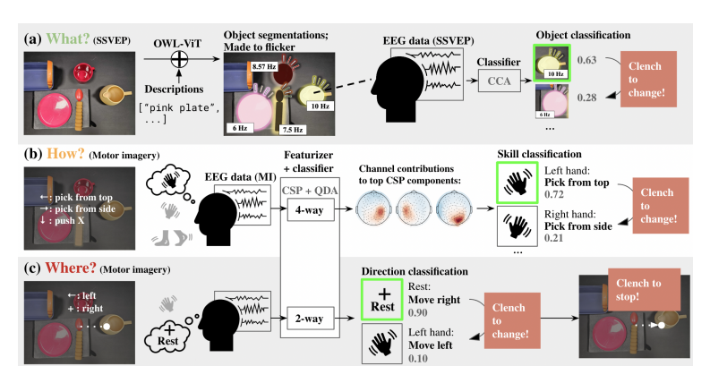
Over Flow Process Explain Through Research Paper
Fig 4: Technical Flow Chart of a System Archicture

Slide 8
Timeline
1. Initial research and system design: 1-3 Weeks
2. Development of modular decoding pipeline: 4-6 weeks
3. Integration with robotic systems and testing: 7-11weeks
4. Data collection and performance evaluation: 11-14 weeks
5. Final optimization and user trials: 15-17 weeks
6. Report writing and submission: 17-20 weeks
Approx:4-5 Months based on stimulations and available softwares

Slide 9
Expected Outcome
A functioning, intelligent BRI system that can assist users in performing daily tasks through brain signals.
Improved interaction efficiency between humans and robots, especially for individuals with disabilities.
Establishment of NOIR as a benchmark for future developments in general-purpose BRI systems.
Future Outcomes:
The system will execute complex, multi-step tasks autonomously without reconfiguration.
NOIR will maintain high performance in unpredictable and changing environments.
NOIR will integrate with smart devices, creating a comprehensive assistive system

Slide 10
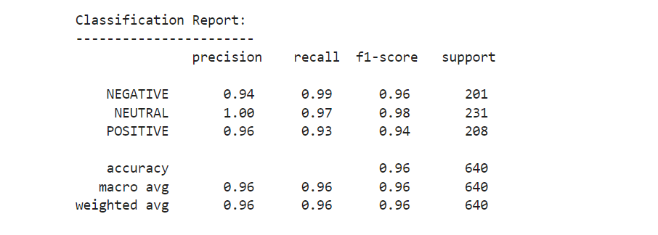
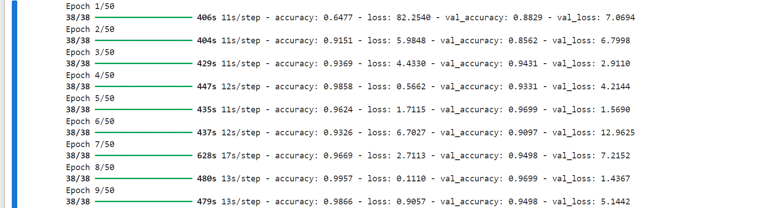
Implementation Results

Slide 11
Conclusion
The NOIR project demonstrates the potential of brain-robot interface (BRI) technology to revolutionize human-robot interaction, enabling individuals to control robots for daily tasks through neural signals. With a focus on adaptability, minimal training, and efficiency, NOIR bridges the gap between existing specialized systems and the need for versatile, real-world applications. Future advancements in machine learning and signal decoding could further enhance the system’s usability, making it a valuable tool for enhancing independence and quality of life, especially for senior citizens and people with disabilities.

